Slide 1

Project Final-Defense Stock Price Prediction Using LSTM
Submitted by: Submitted to:
Anurani Karki (2022-01-53-0153) Er.Nishan Khanal
Denish Acharya (2022-01-53-0157)
Semester: Fourth
Program: BCA
Date: 02 August, 2024

Slide 2
Presentation Outline
Introduction...............................................................................................4
Motivation.................................................................................................5
Background...............................................................................................6
Problem Statement....................................................................................7
Objectives of Project.................................................................................8
Scope of Project........................................................................................9
Originality of project................................................................................10
Potential Application................................................................................11
Literature Review......................................................................................12
Methodology.............................................................................................17
Result........................................................................................................37
Discussion and Analysis...........................................................................43

Slide 3
Future Enhancements..................................................................................................47
Project Schedule..........................................................................................................48
References...................................................................................................................49

Slide 4
Introduction
A stock known as a share, signifies ownership in a business or corporation held by an individual or group.
The stock market is a complex and dynamic system influenced by numerous factors.
The stock market plays a crucial role in the global economy, attracting millions of investors and traders seeking to capitalize on financial opportunities.

Slide 5

Motivation
fig: Motivation

Slide 6
Background
Accurate stock price prediction is crucial for investors, institutions, and businesses.
Challenges include market volatility and complexities in traditional prediction methods.
Machine learning, particularly deep learning techniques like LSTM networks, offers innovative solutions.
LSTM networks are designed to capture long-term dependencies in data, making them suitable for time-series forecasting.

Slide 7
Problem Statement
The SVR model struggles with capturing patterns effectively.
CNN models face challenges in interpreting their learnings.
RNN has exploding and vanishing gradient problem.

Slide 8
Objectives of project
To address the challenge of accurately predicting stock prices in a volatile and complex market environment.
To overcome the limitations of traditional forecasting methods in stock price prediction.

Slide 9
Scope of project
CAPABILITIES
It analyses extensive historical stock market data.
Ability to capture complex patterns and dependencies within the data.
Facilitates more informed decision-making in the financial field.
LIMITATIONS
Dependency on the accuracy and completeness of historical market data.
The dynamic nature of market conditions introduces complexities.

Slide 10
Originality of Project
The project is crucial forecasts stock prices by capturing complex patterns in sequential data.
Creates reliable predictive models that leverage historical market data and economic indicators.
Provides actionable insights and support informed decision-making in the ever-changing stock market environment, benefiting individual investors, financial institutions.

Slide 11
Potential Applications
Financial Decision Making
Algorithmic Trading
Risk Assessment
Market Trend Analysis
Financial Planning
Educational Tools
Research and Development

Slide 12
Literature Review-I
Paper | Year | Authors | Methodology | Results | Weakness | Strengths
Regression Techinques For The Prediction Of Stock Price Trend | 2012 | Siew, Han Lock and Nordin, Md Jan | Machine learning techinques. SMO regression techniques. | Highlights potential of data transformation in regression methods. | Relies excessively on regression, neglecting thorough evaluation and external validation. | The logic is consistent with accepted market theories.

Slide 13
Literature Review-II
Paper | Year | Authors | Methodology | Results | Weakness | Strengths
Short Term Stock Price Prediction Using Deep Learning | 2017 | Kaustubh Kahre, Omkar Darekar, Prafull Gupta, V.Z, Attar | Neural Networks, Deep Learning techniques, Feed Forward Multilayer Perception and Long Short-Term Memory | MLP models predict the exact proces with higher accuracy. LSTM outperforms traditional methods and challenges the efficient market hypothesis. | LSTM are complex with many parameters and requires extensive data preprocessing. MLP can’t be used to treat prediction problems as time-series problems. | LSTM can learn and recognize complex patterns in the stock price. MLP has ability to reduce the errors.

Slide 14
Literature Review-III
Paper | Year | Authors | Methodology | Results | Weakness | Strengths
Stock Price Prediction Using LSTM,RNN AND CNN-Sliding Window Model | 2017 | Sreelekshmy Selvin, Vinayakumar R, Gopalakrishnan E.A, Vijay Krishna Menon, Soman K.P | Machine Learning techniques, CNN based framework, RNN based framework, LSTM based framework | Using LSTM , the analysis of time dependent data become more efficient. | Heavily rely on historical datas. | Handle sequential data and extracting relevant features.

Slide 15
Literature Review-IV
Paper | Year | Authors | Methodology | Results | Weakness | Strengths
Stock Market Prediction Using LSTM Recurrent Neural Network | 2020 | Adil Moghar, Mhamed Hamiche | Recurrent Neural Network,ANN and LSTM | LSTM analyzes time dependent data. RNN and LSTM utilize earlier data to learn patterns and forecast future trends. | Requires more epochs and slower to train. | Layers of ANN improve our predictions and minimize the predictions errors. LSTM retains data for future use and for change in future trends.

Slide 16
Literature Review-V
Paper | Year | Authors | Methodology | Results | Weakness | Strengths
Stock Price Prediction Using LSTM and SVR | 2020 | Gourav Bathla | Long Short-Term Memory, Support Vector Regression | LSTM can provide better accuracy in predicting stock prices compared to SVR. | LSTM’s gates allow it to selectively remember or forget information, enhancing prediction accuracy. | SVR minimizes error using most suitable hyperplane. LSTM can analyzes time series data.

Slide 17
Methodology
This project is done using deep learning models that is Recurrent Neural Networks and Long Short-Term Memory.

Slide 18
Instrumentation Requirements
Requirements | Details
Software Requirements | Operating system: Windows 10 or 11 Browser: Edge Preferred (any) Application: VS Code, Jupyter Notebook
Hardware Requirements | RAM: 4 GB minimum Internet: Minimum 10 Mbps SSd: 128 GB CPU: i5, atleast 2GHz
Libraries | Sklearn Pandas Numpy Math Matplotlib Keras Numpy
Language | Python

Slide 19
Algorithm
1. Forget Gate
Function: Determines which information from the previous time step should be discarded.
Operation: Applies a sigmoid activation function to a combination of the previous hidden state and the current input, outputting a value between 0 and 1 for each element in the memory cell.

Slide 20
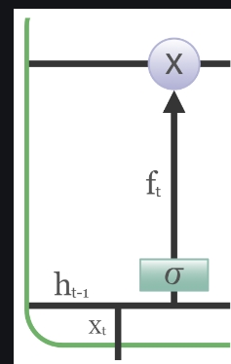
Fig: Forget Gate

Slide 21
2. Input Gate
Function: Decides which new information should be stored in the memory cell.
Operation: Combines the current input and the previous hidden state, passes the result through a sigmoid activation to produce a candidate value for updating the memory cell. This candidate value is then scaled by another sigmoid function.

Slide 22
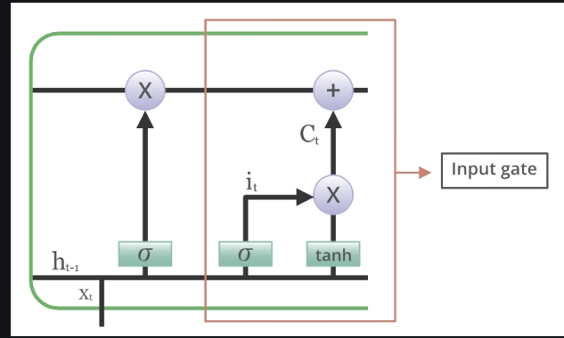
Fig: Input Gate

Slide 23
Output Gate
Function: Controls the flow of information from the memory cell to the network output.
Operation: Combines the current input with the previous hidden state, passes the result through a sigmoid activation function, and determines how much of the cell state’s contents should be passed to the output.

Slide 24
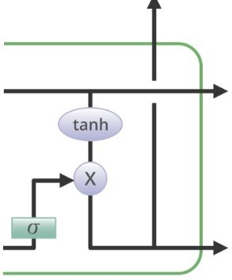
Fig: Output Gate

Slide 25
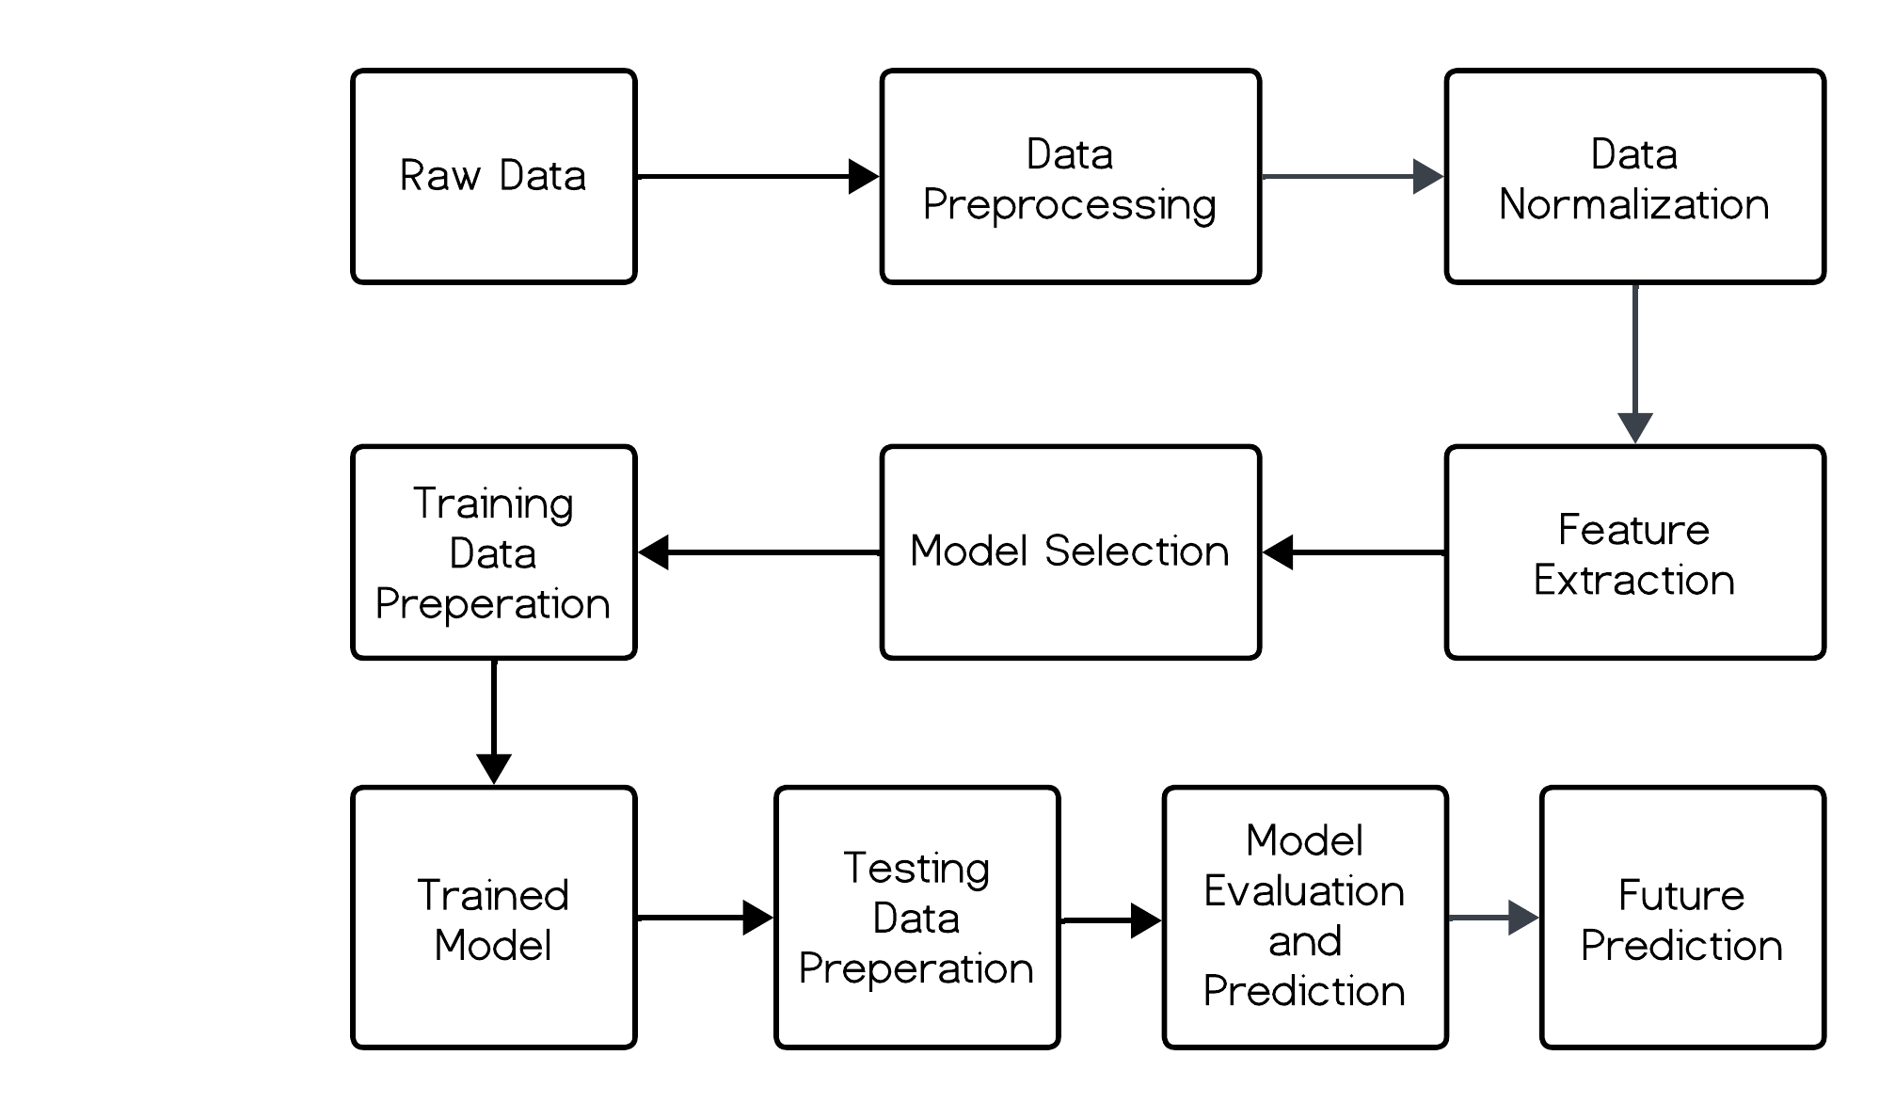
2. System Block Diagram
fig: System Block Diagram

Slide 26
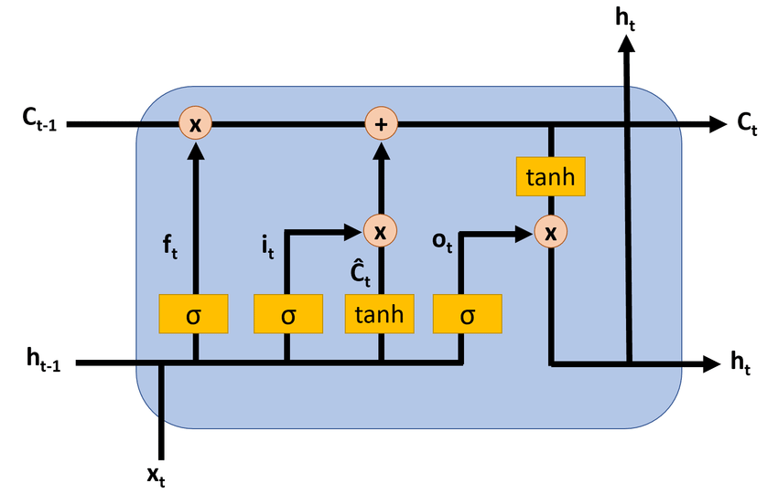
Figure: LSTM Architecture

Slide 27
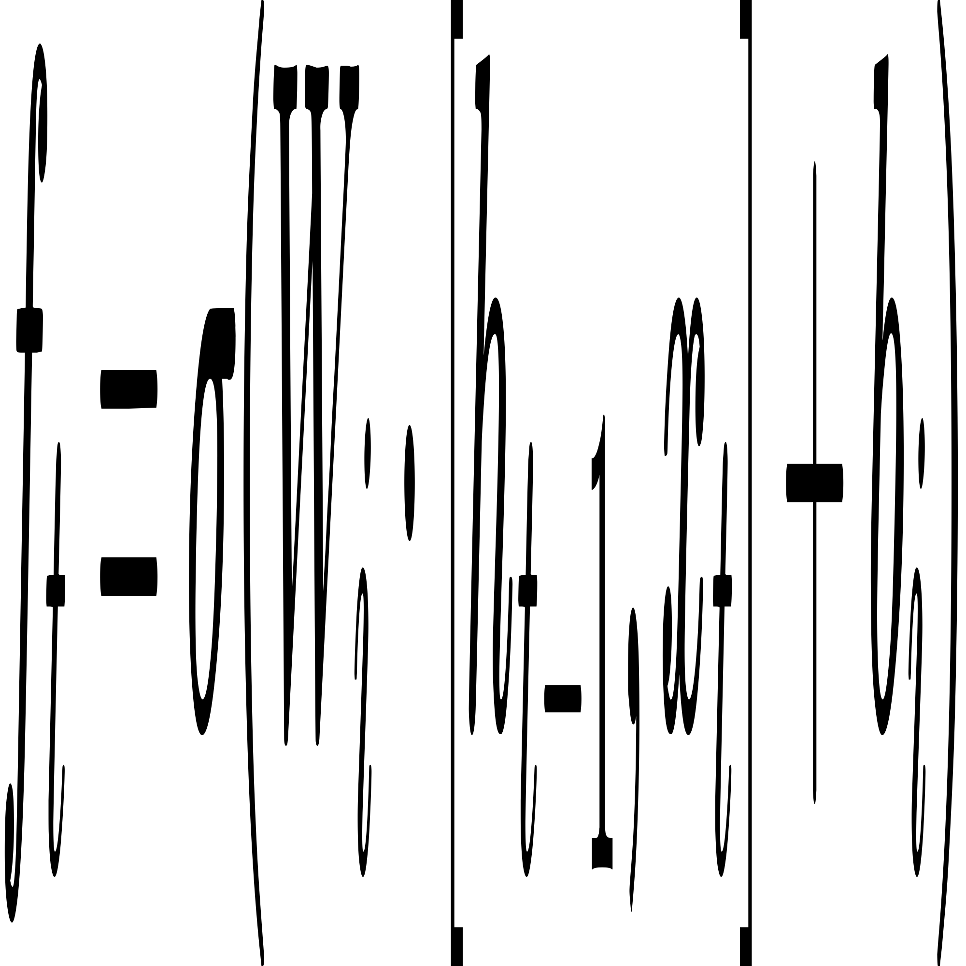
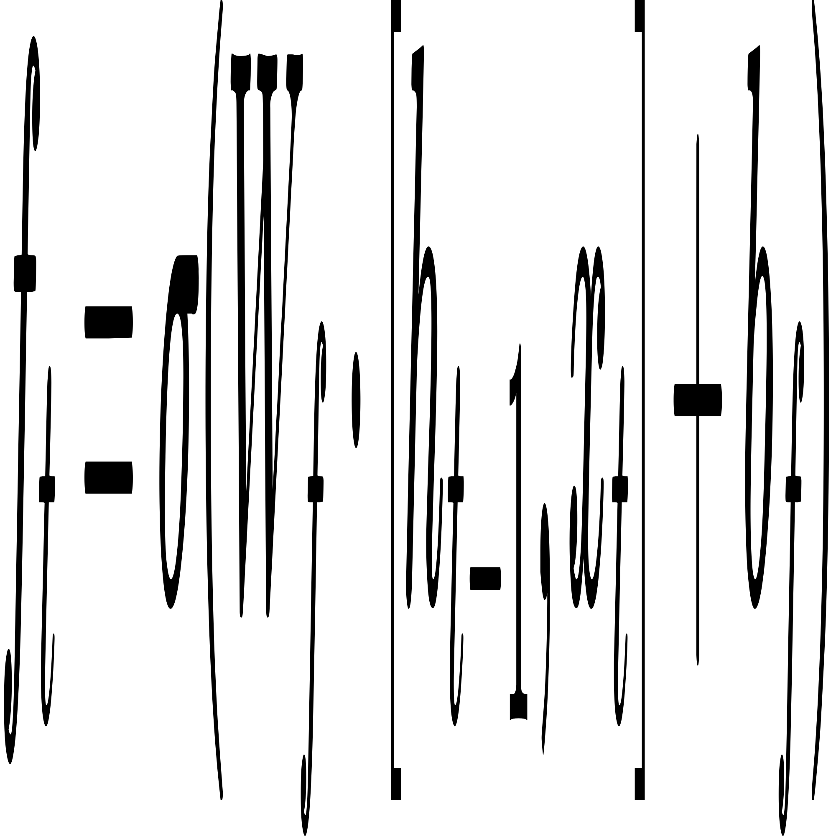
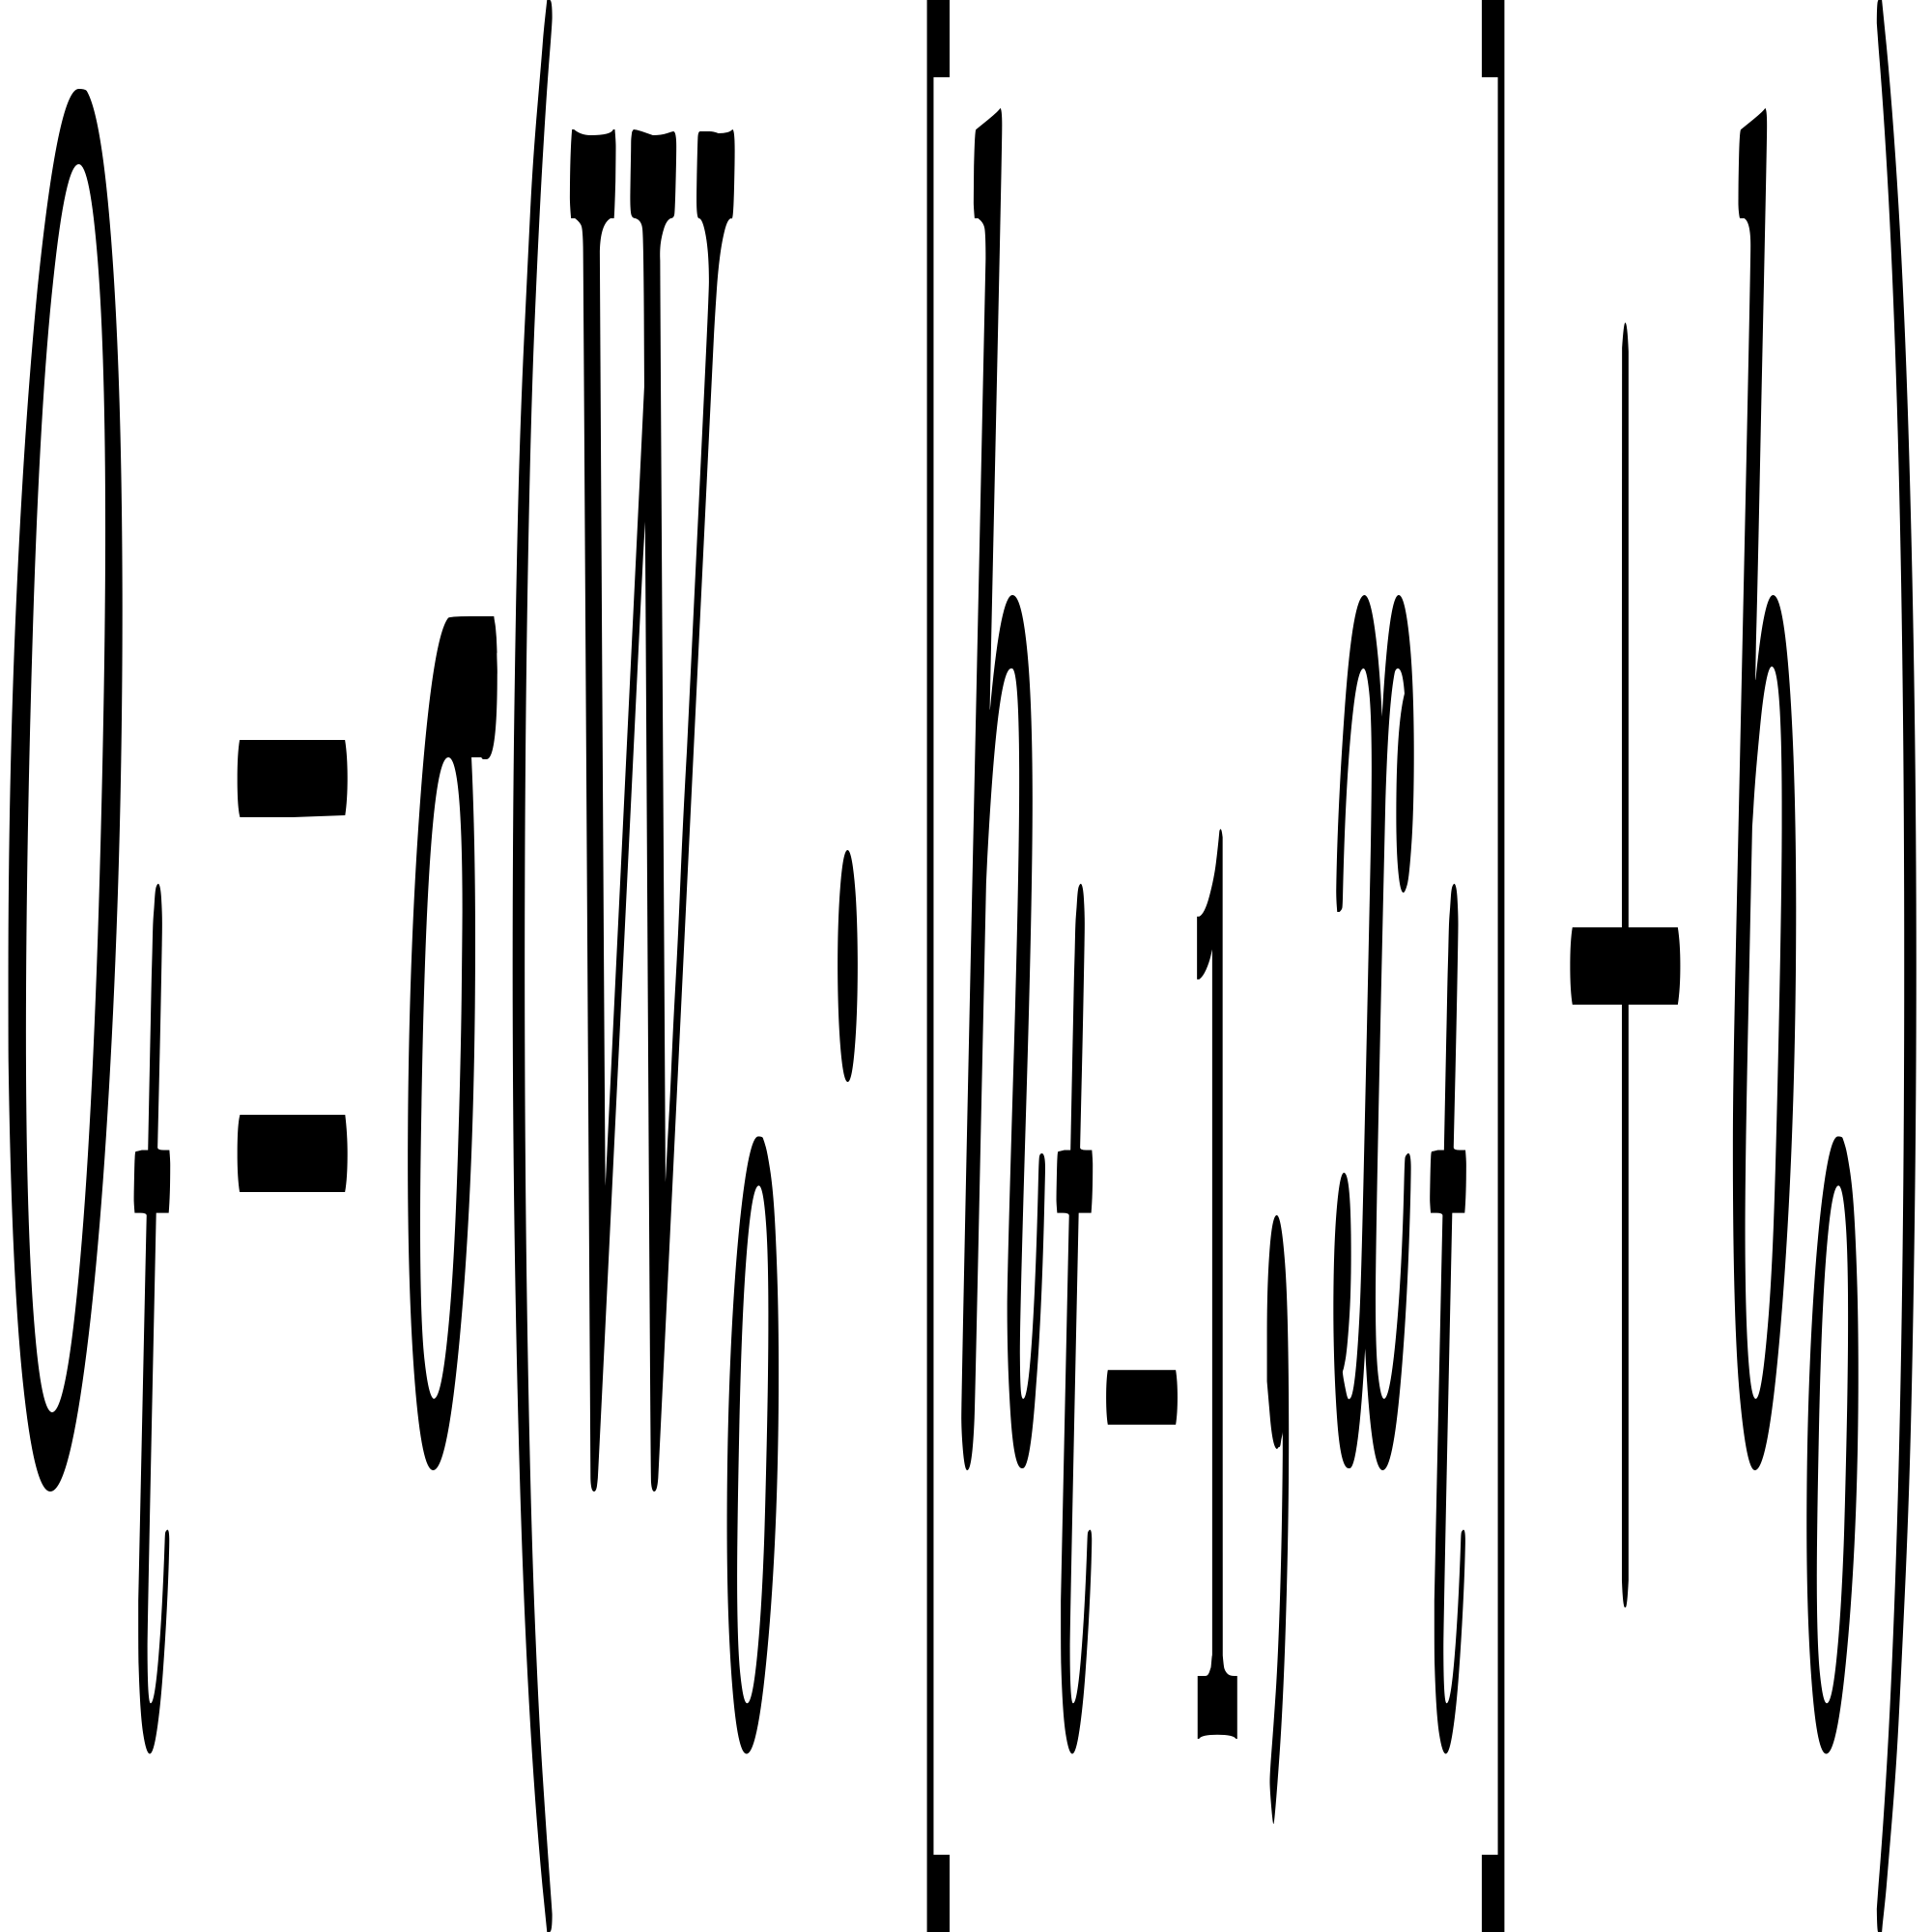
3. Mathematical Modeling
Input Gate:
Forget Gate:
Output Gate:

Slide 28
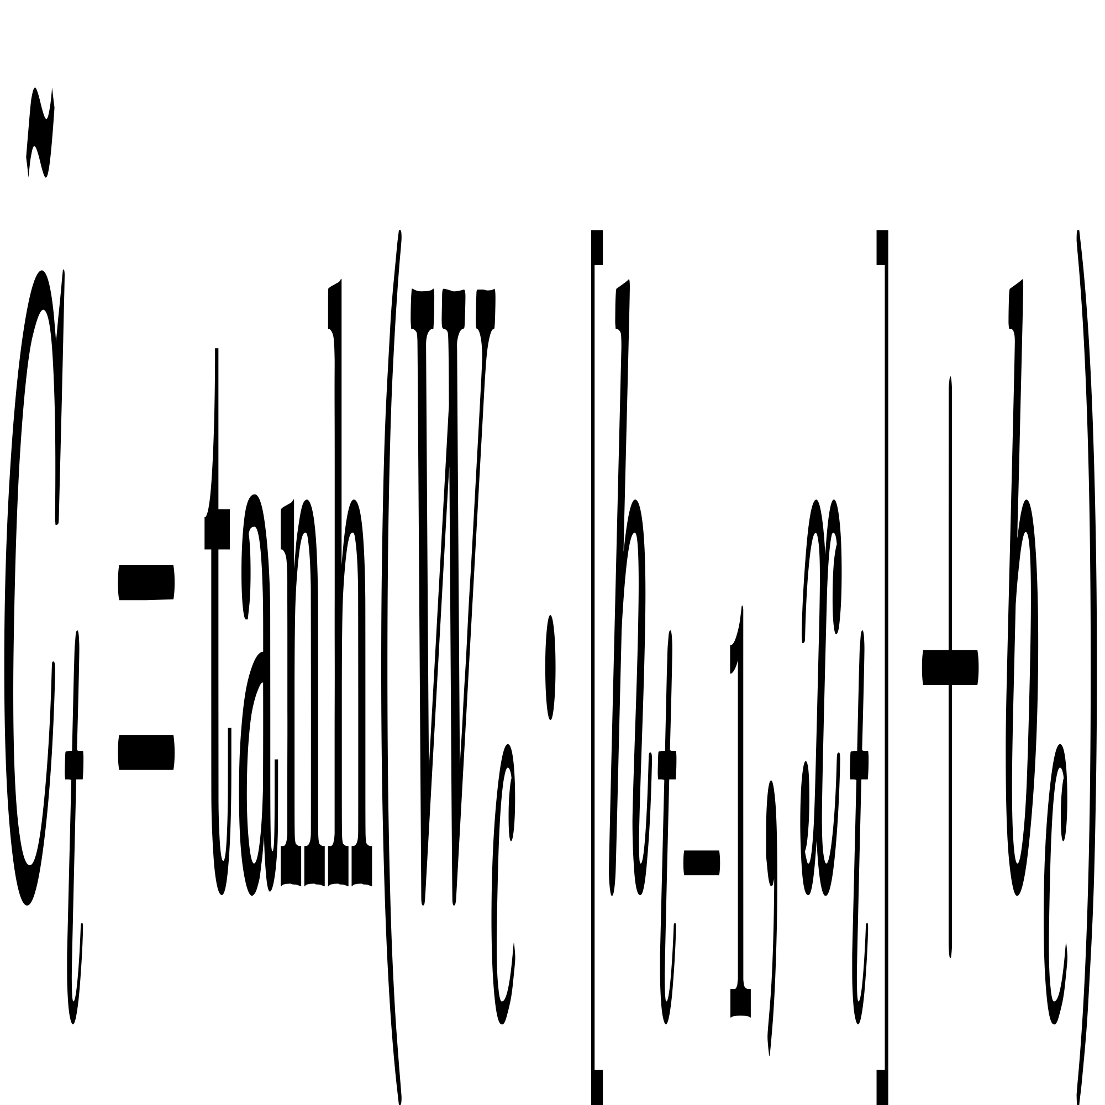
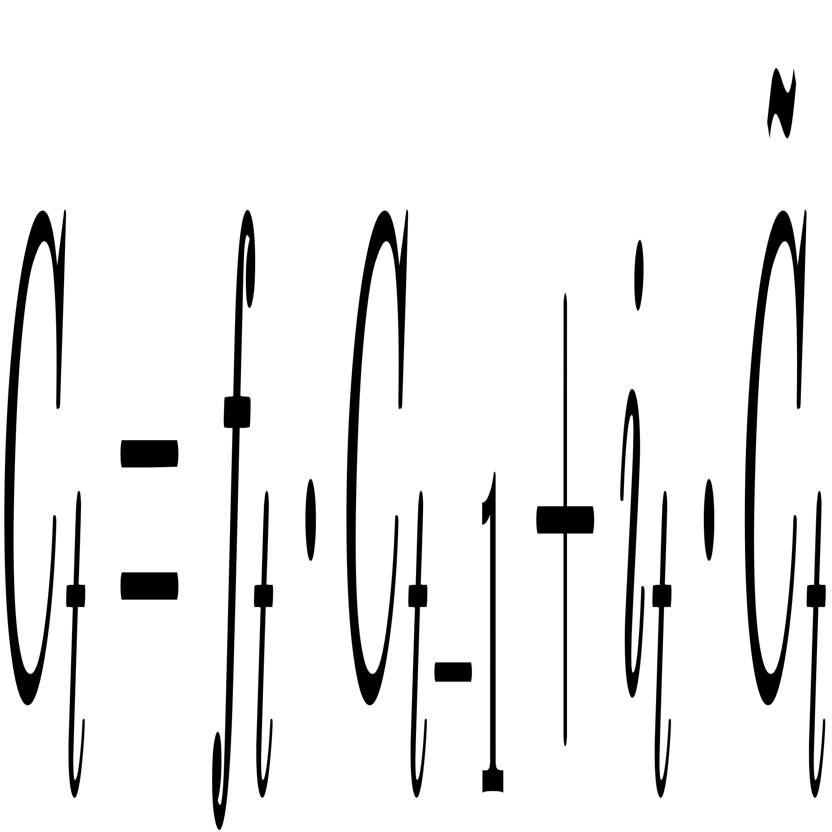
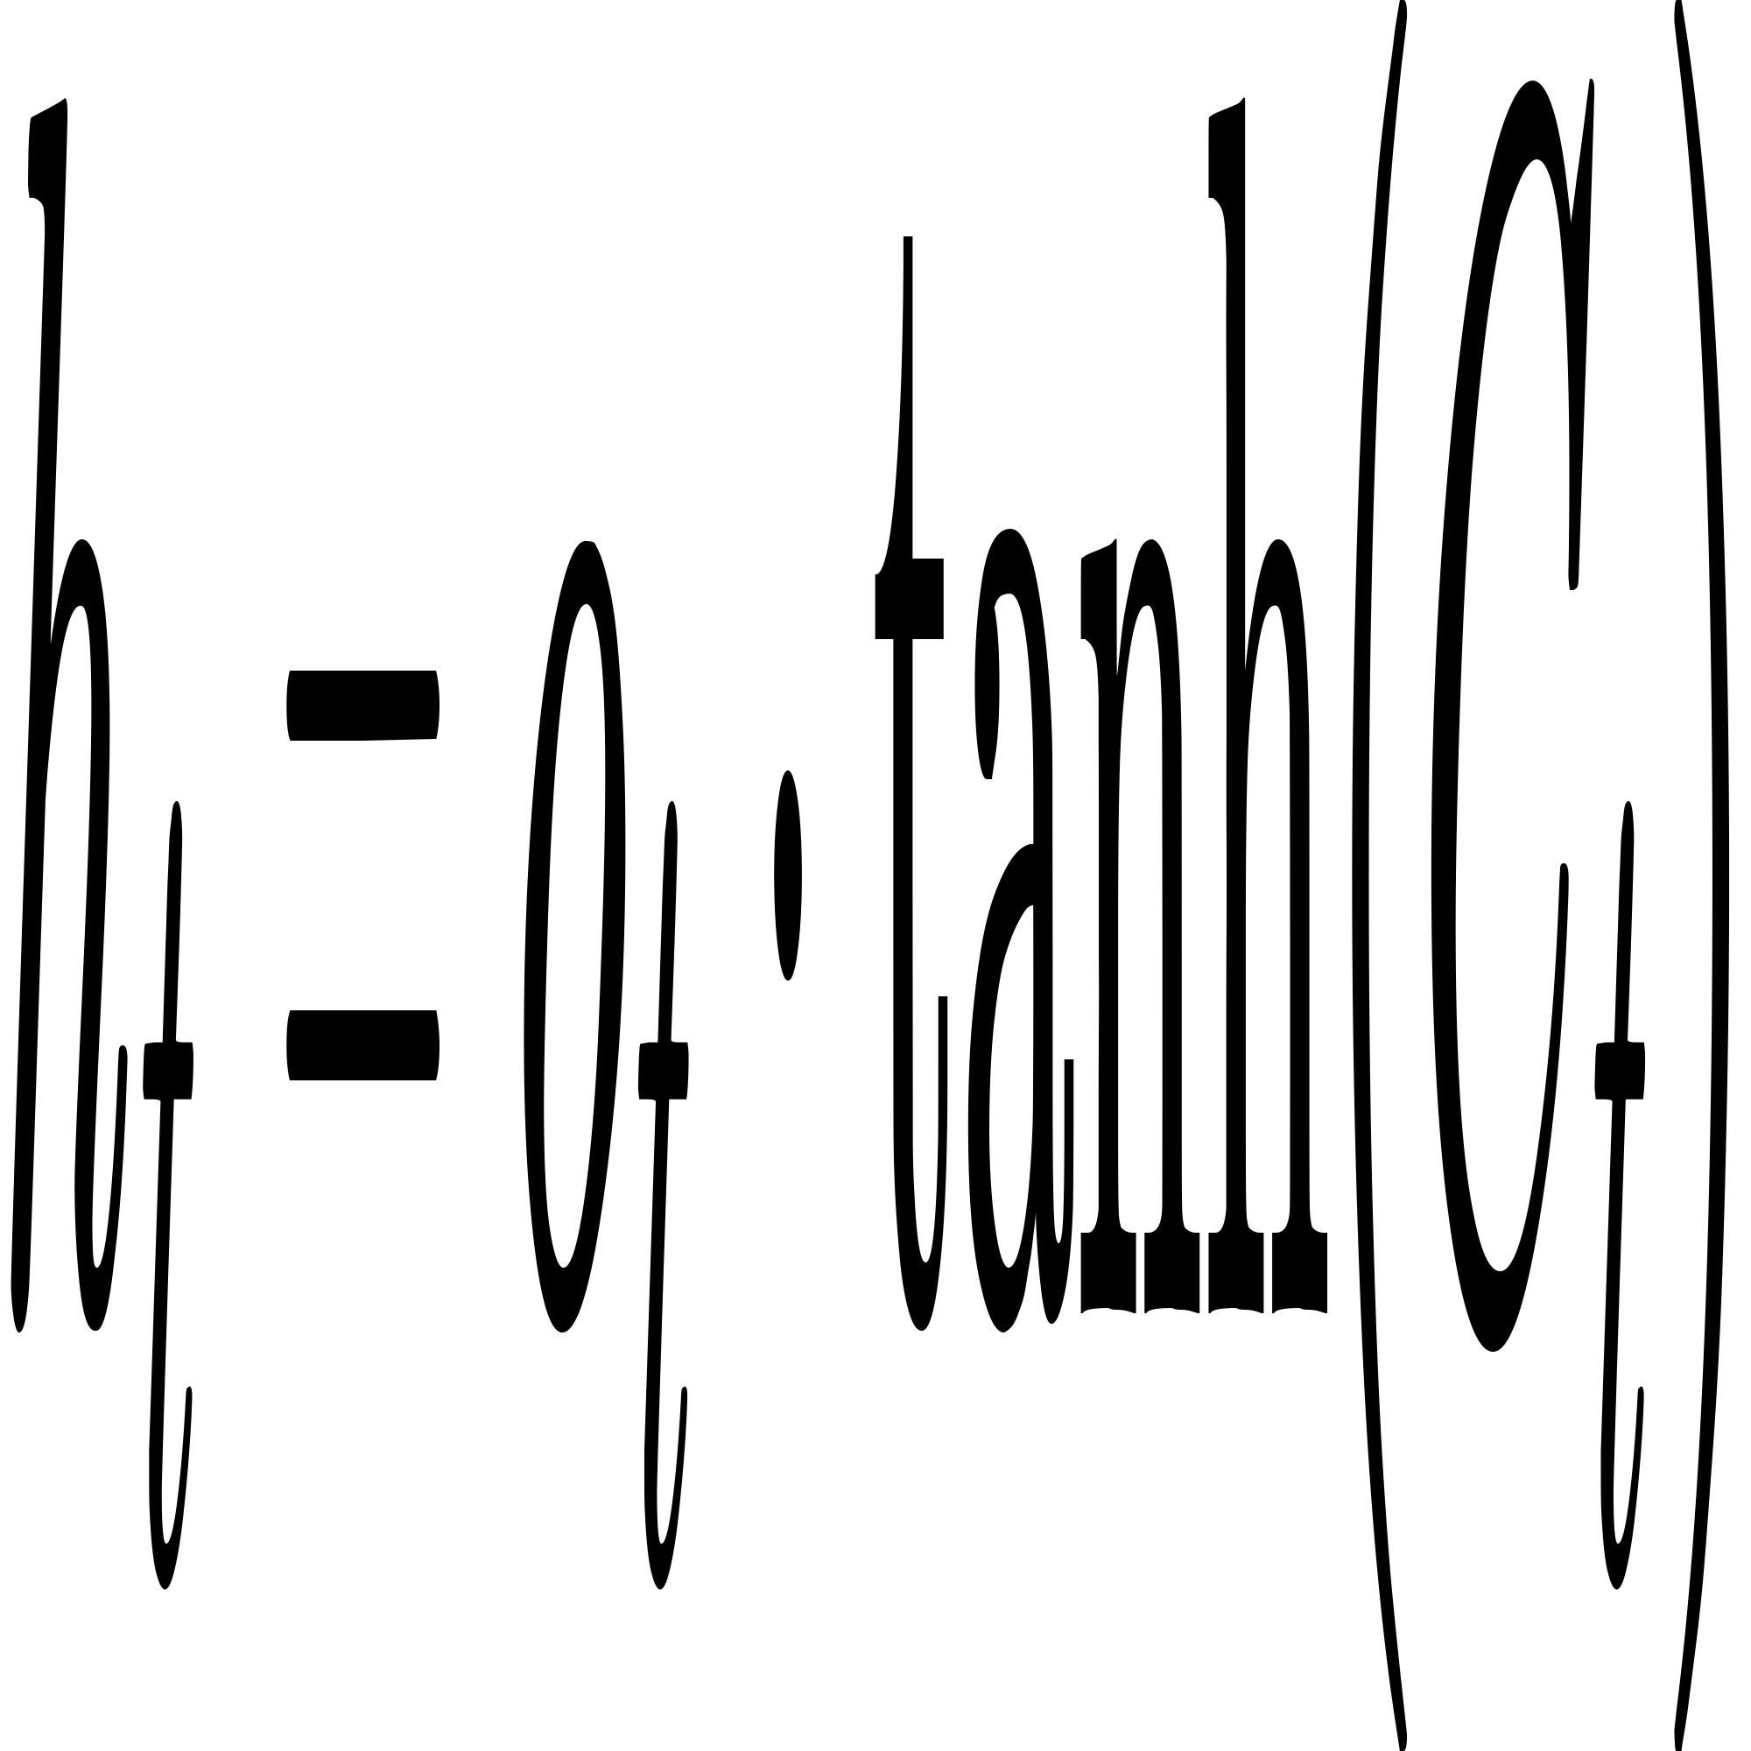
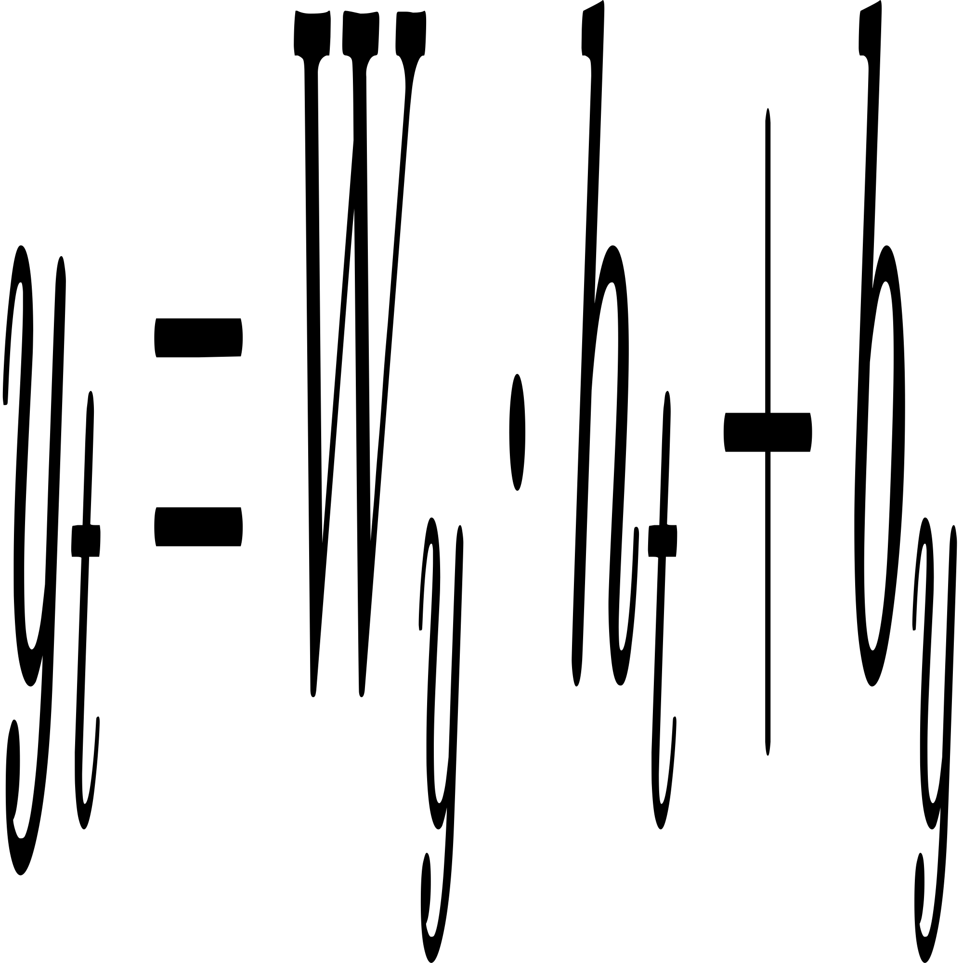
Candidate Cell State:
Cell State Update:
Hidden State:
Output Layer:

Slide 29
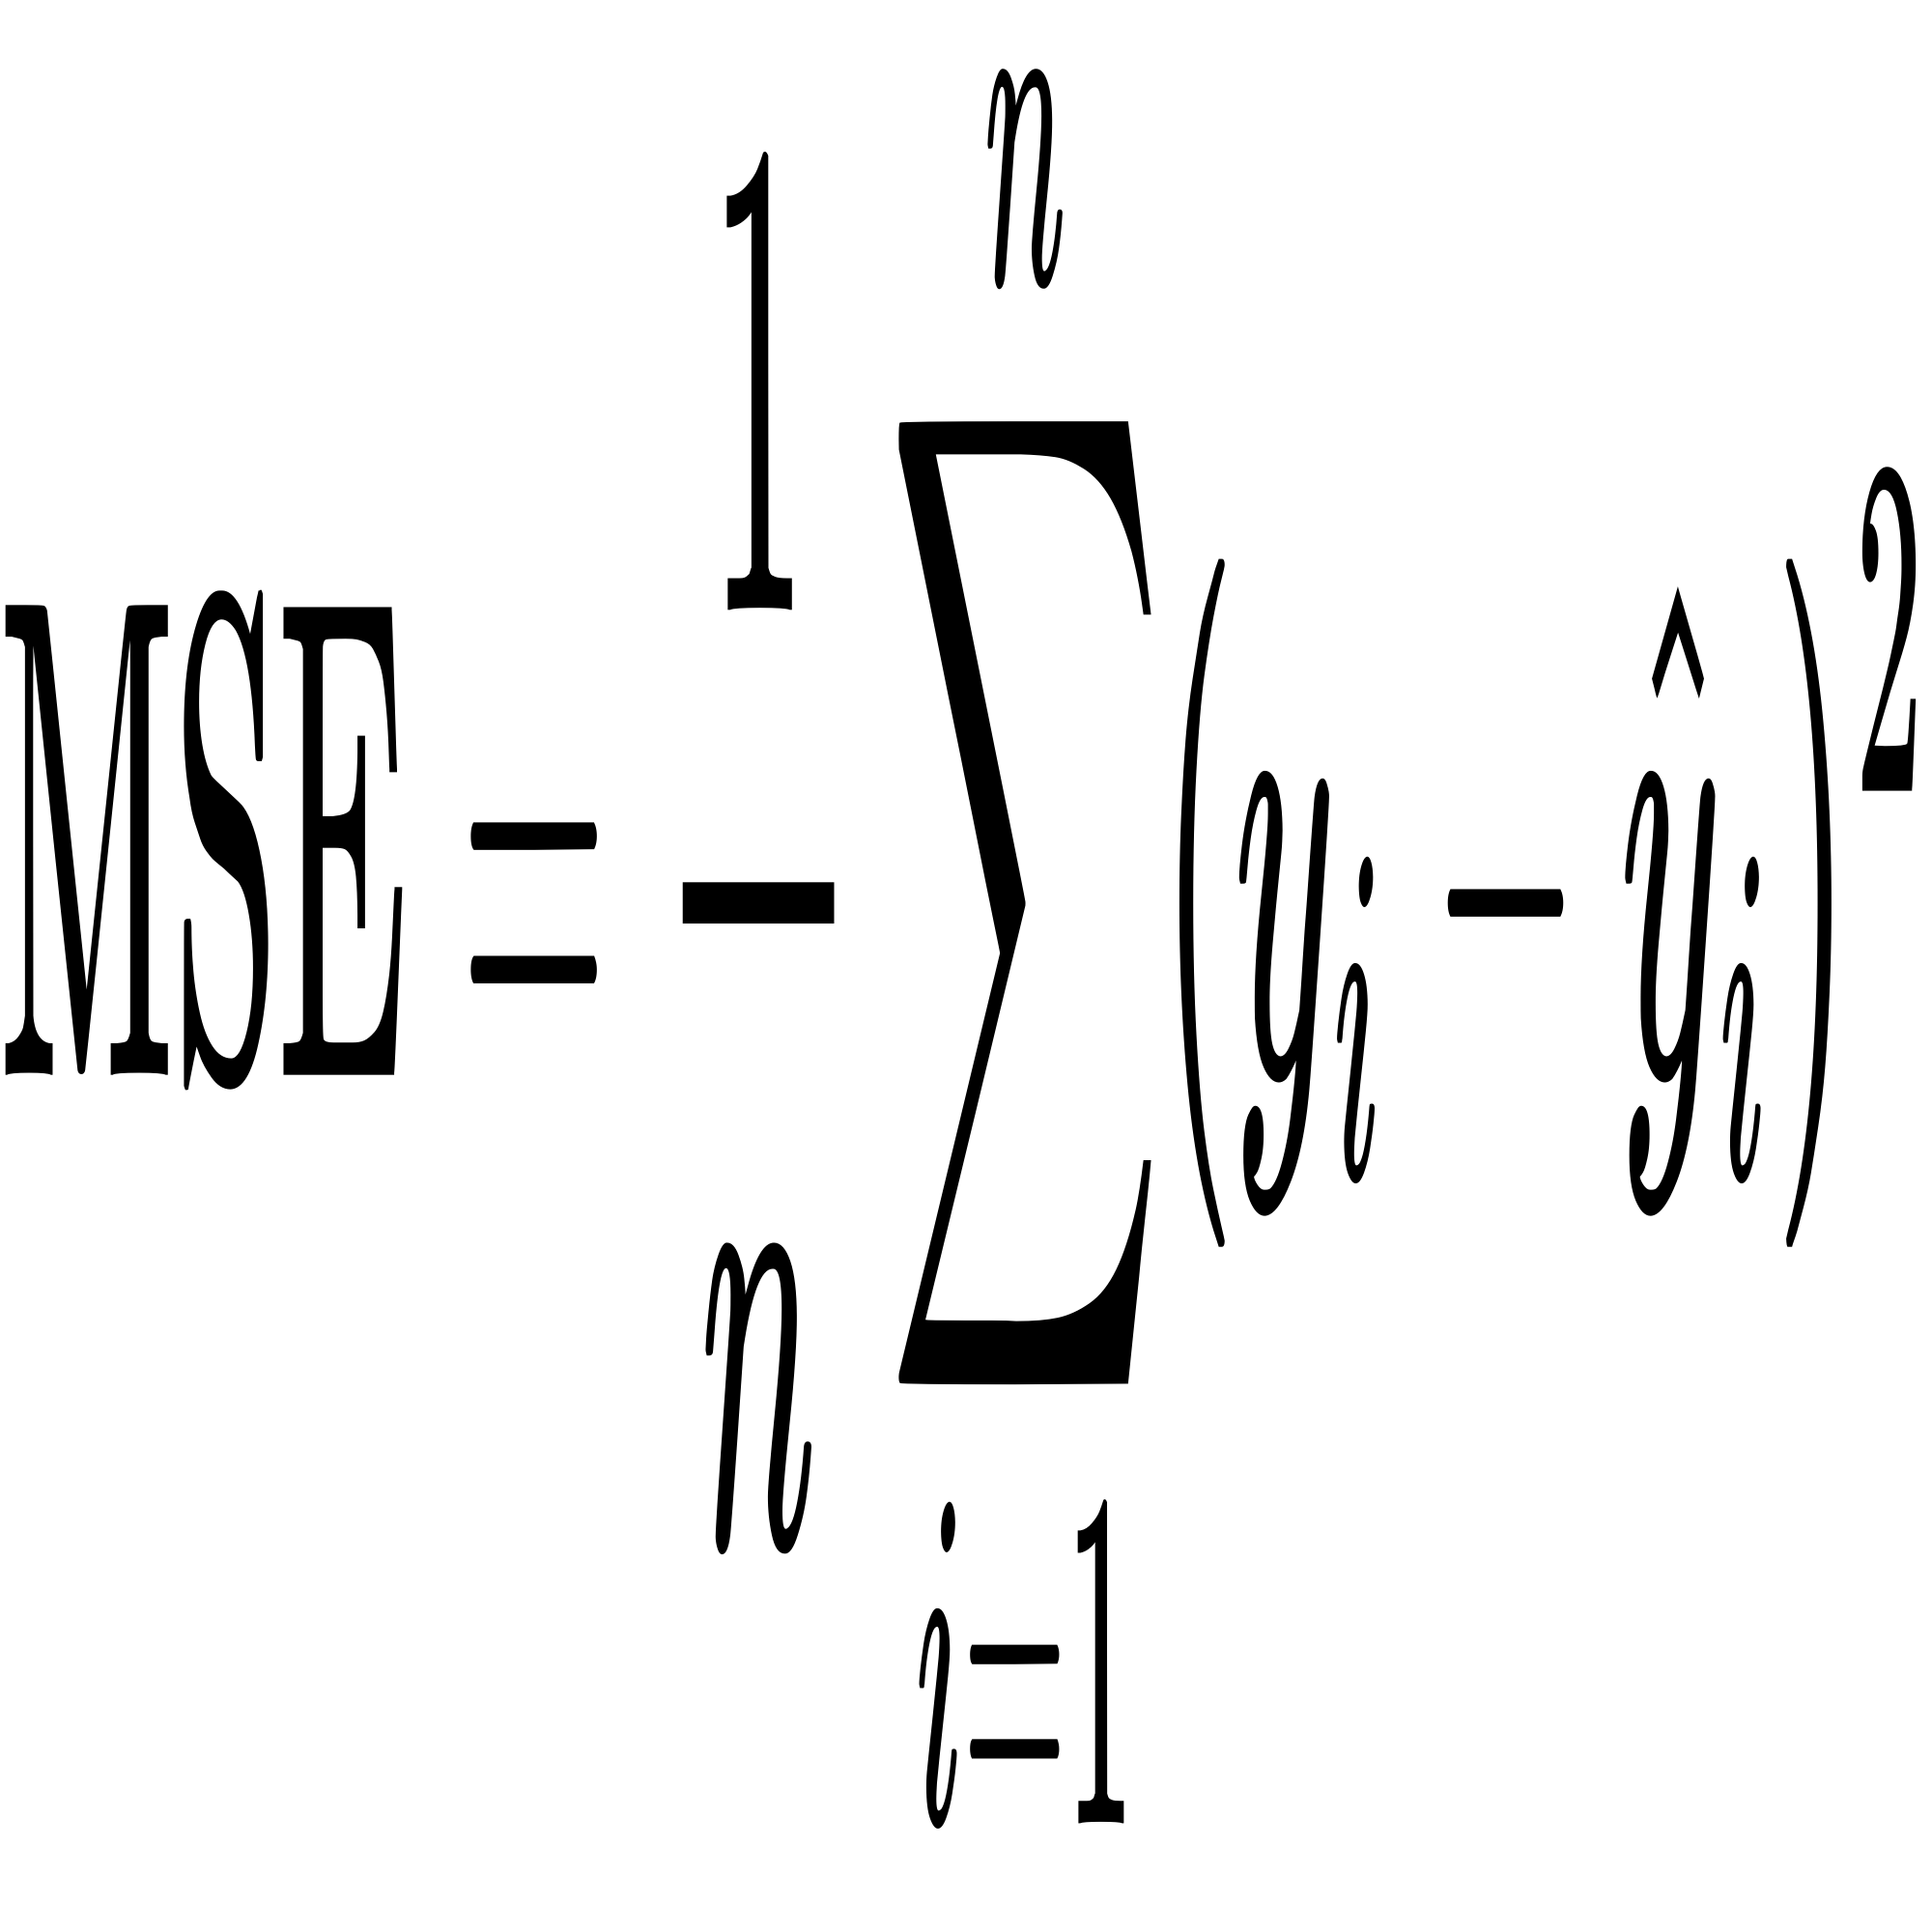
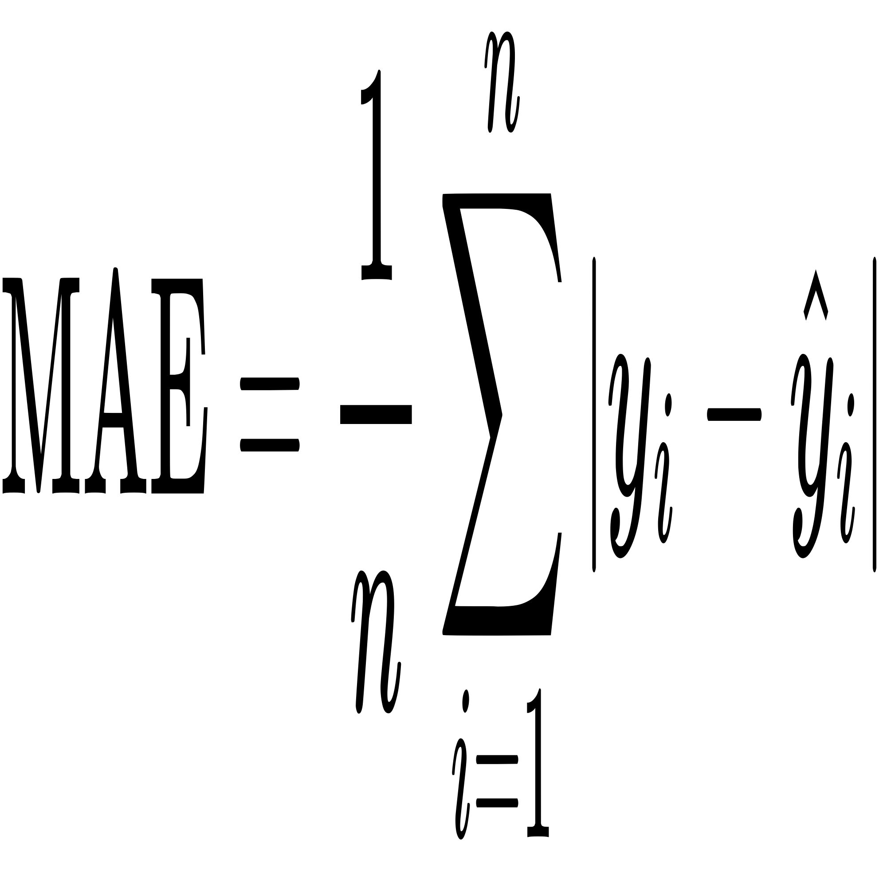
Performance Metrices
Mean Squared Error:
It is the average of the squares of the errors that is, the average squared difference between the actual and predicted values.
Mean Absolute Error:
It is the average of the absolute differences between the actual and predicted values.

Slide 30
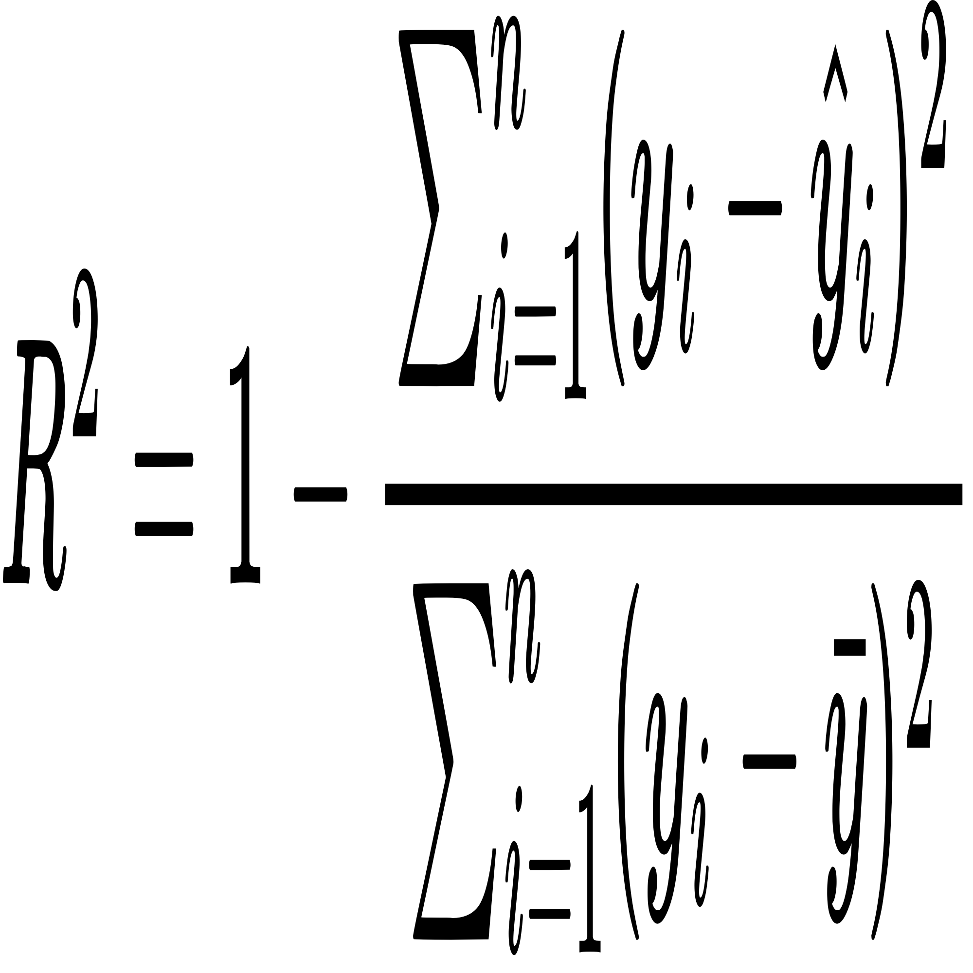
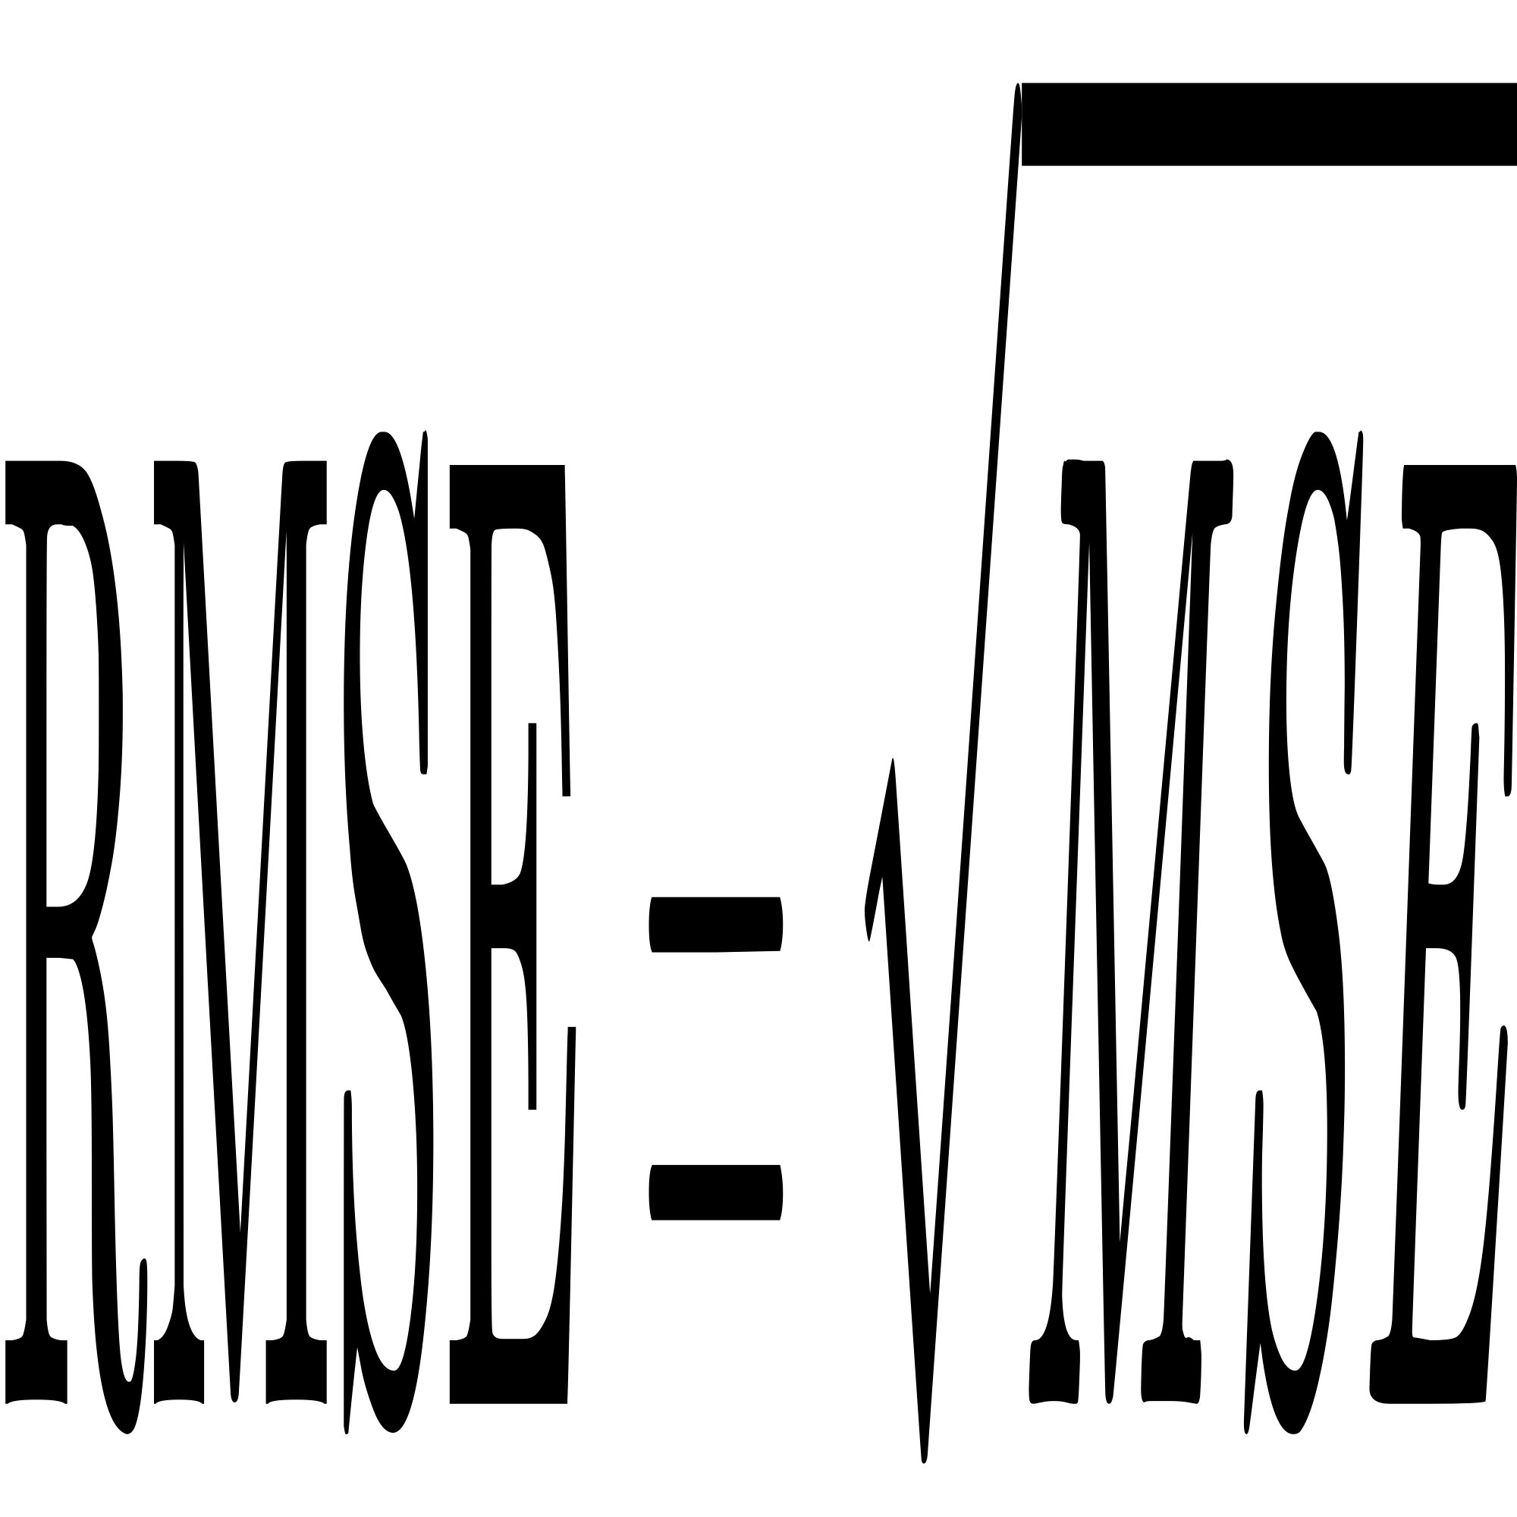
R-squared / Coefficient of Determination:
The Coefficient of Determination measures the proportion of the variance in the dependent variable that is predictable from the independent variables
Root Mean Square Error:
The differences between predicted and observed values. It is calculated as the square root of the average of the squares of the errors.

Slide 31
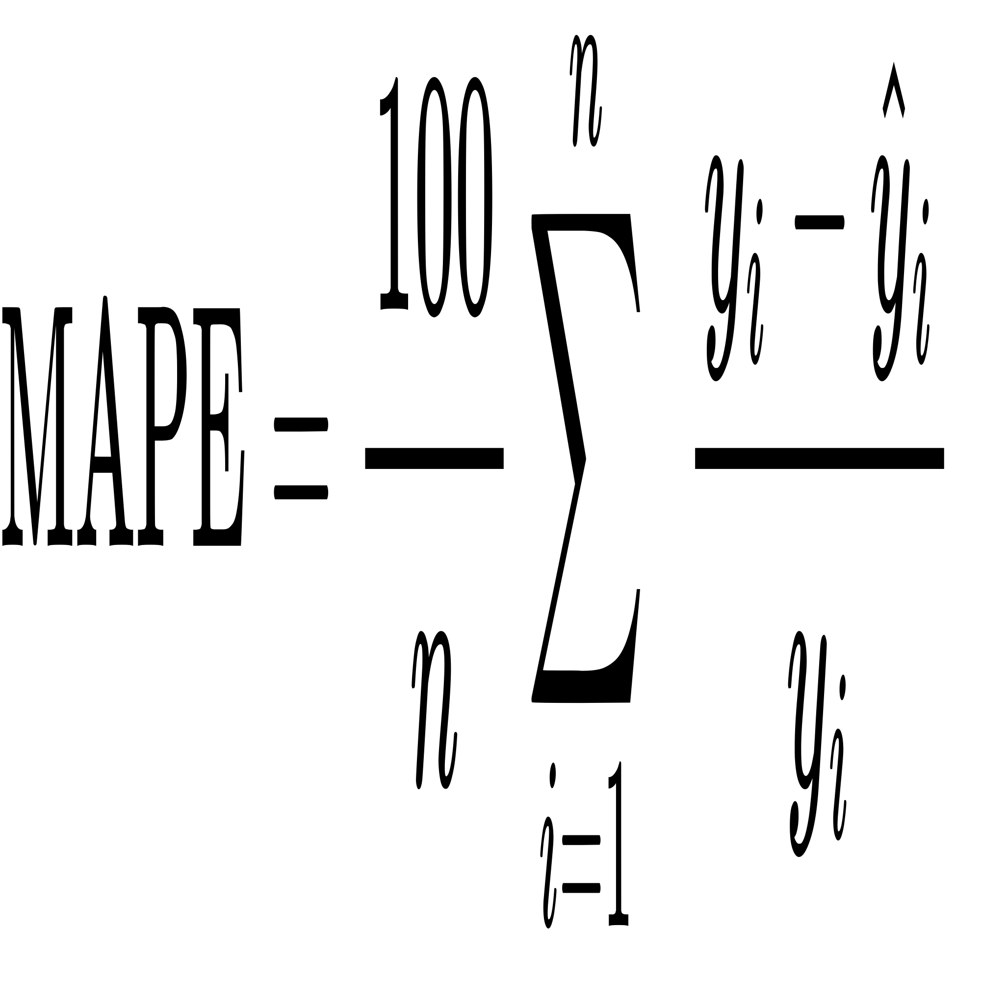
Mean Absolute Precentage Error:
The measure of prediction accuracy of a forecasting method. It expresses accuracy as a percentage and is calculated as the average of the absolute percentage errors of the predictions.

Slide 32
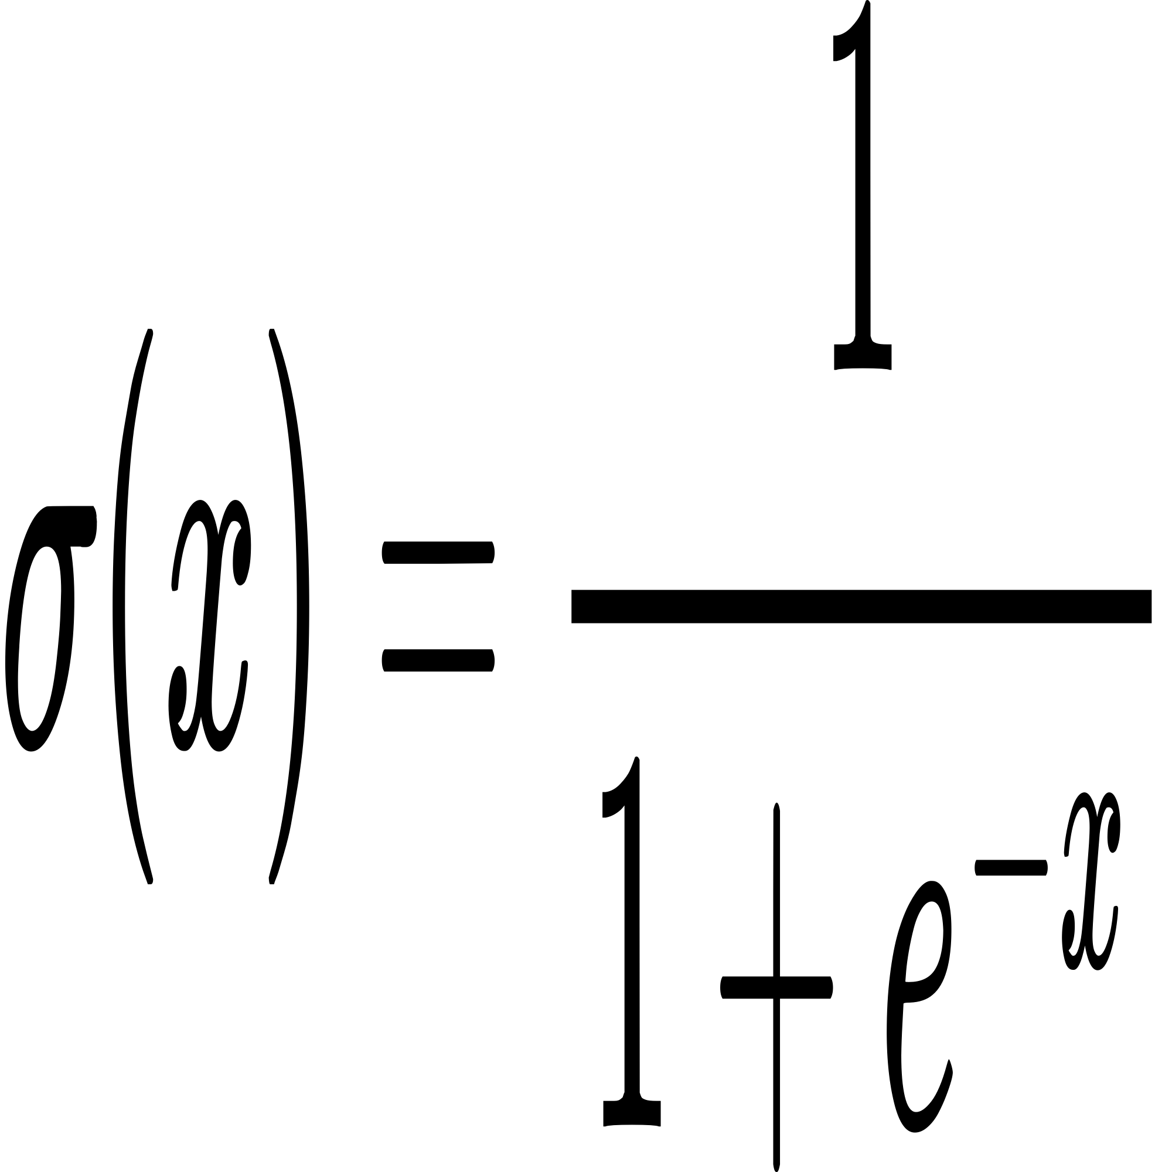
Activation Function
Sigmoid Function:
This is used in the LSTM gates (input gate, forget gate, output gate) to control the flow of information.
Equation :

Slide 33
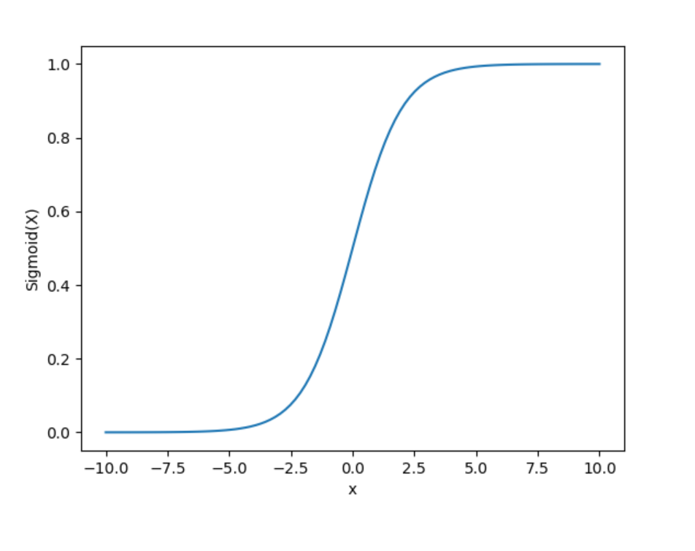
Fig: Sigmoid Function

Slide 34
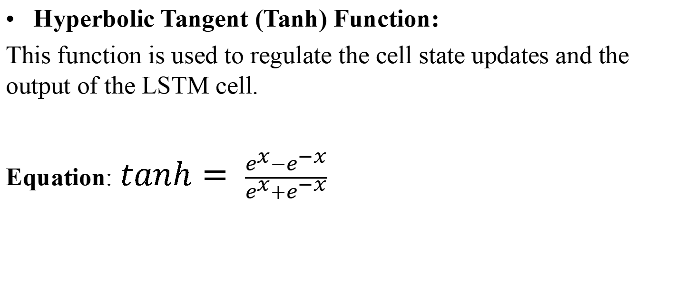
Hyperbolic Tangent (Tanh) Function:
This function is used to regulate the cell state updates and the output of the LSTM cell.
Equation: $tanh= \frac{e^{x}−e^{−x}}{e^{x}+e^{−x}}$

Slide 35
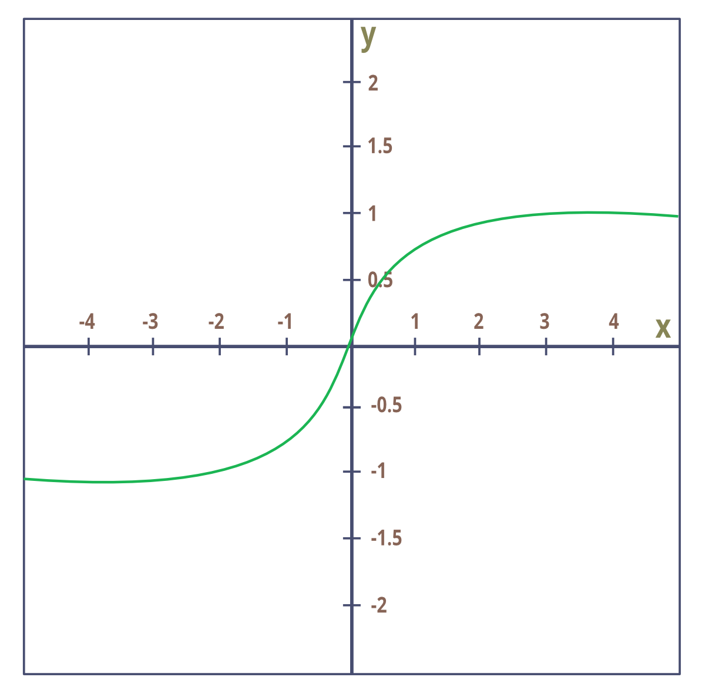
Fig: Hyperbolic Tangent function

Slide 36
Dataset Explanation
Sources of Data: NEPSE and MEROLAGANI
Dataset details:
NABIL AND CBBL:
Timeframe: 2007 - 2024
Date, security ID and Close value are collected.
SBL:
Timeframe: 2014-2024
Date, close value, opening value, high value, low value , quantity and turnover are collected.

Slide 37
RESULT
Best Case Scenario: The model's predictions closely matched the actual stock prices, indicating high accuracy and reliability.
Training data used: 75% of SBL stock (1,516 close value) data from 7/30/2014 to 7/23/2024.
Model settings: Batch size of 64 and 100 epochs and total batch will be 24.
Performance:
Metric | Value
RMSE | 5.6315
MAE | 3.8772
R squared | 0.9809
MAPE | 1.3987%
Accuracy | 98.6012%

Slide 38
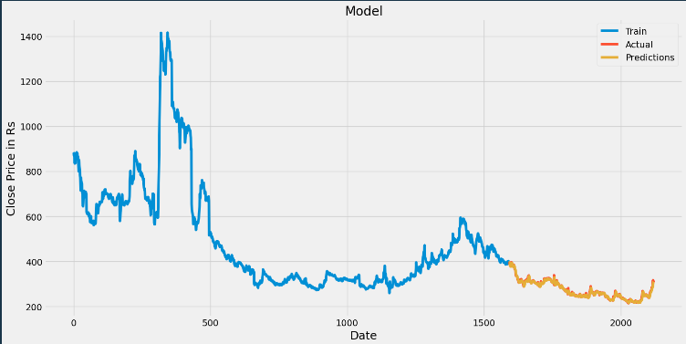
Fig: Best Case Scenario

Slide 39
Worst Case Scenario: The model's performance was less accurate, with larger prediction errors compared to the best case scenario.
Data Used: 35% of SBL stock data (735 close value) from the from 7/30/2014 to 7/23/2024.
Model settings: Batch size of 8 and 25 epochs and total batch will be 92.
Performance:
Metric | Value
RMSE | 52.94697
MAE | 42.91542
R squared | 0.55884
MAPE | 14.4859 %
Accuracy | 85.514021%

Slide 40
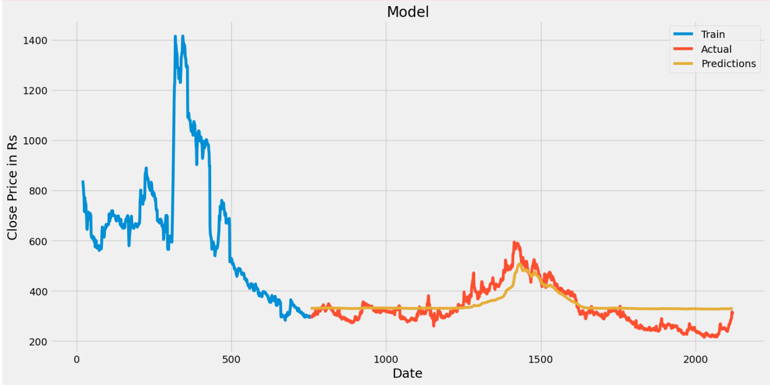
Fig: Worst Case Scenario

Slide 41
Performance Metrics Evaluation
Metric | Best Case | Worst Case
RMSE | 5.6315 | 52.94697
MAE | 3.8772 | 42.91542
R squared | 0.9809 | 0.55884
MAPE | 1.3987% | 14.4859 %
Accuracy | 98.6012% | 85.514021%

Slide 42
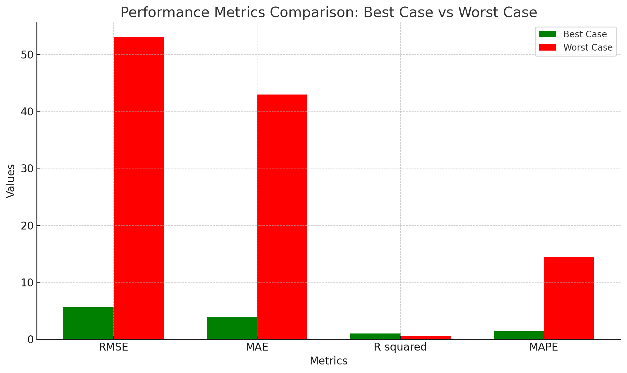
Fig: Best Case Vs Worst Case Performance metrics

Slide 43
DISCUSSION AND ANALYSIS
Best Case and Worst Case Comparison
Best Case: Predicted prices closely matched actual prices, indicating high accuracy in favorable conditions based on historical data.
Worst Case: Larger deviations in predicted prices from actual values, reflecting greater uncertainty in adverse conditions based on historical data.

Slide 44
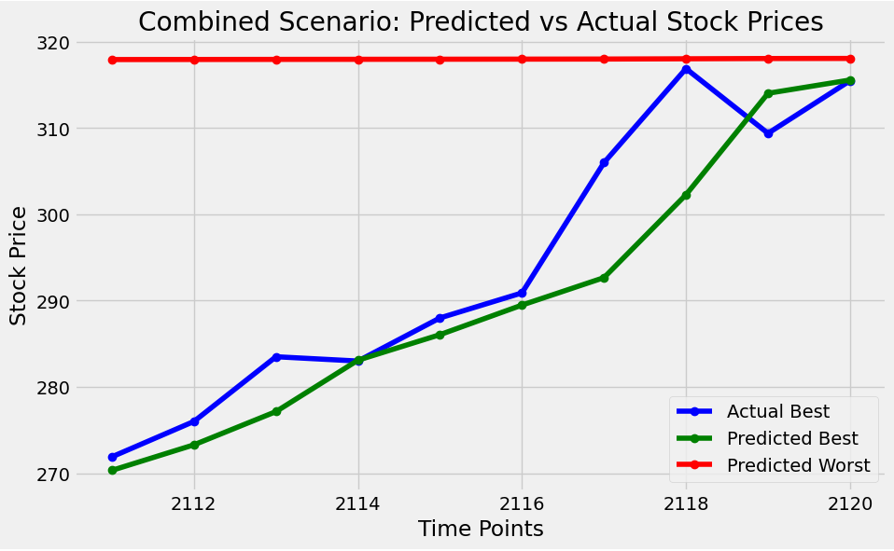
Fig: Best Case Vs Worst Case

Slide 45
Error Analysis
Higher RMSE and MAE indicate larger prediction errors, especially during volatile periods.
Low R² and high MAPE reflect poor variance explanation and accuracy in predictions.
Data preprocessing issues and normalization inconsistencies can lead to poor model performance.
Hyperparameter tuning challenges and market volatility impact model accuracy, increasing prediction errors.

Slide 46
Comparison with State-of-the-Art Methods
LSTM outperforms CNNs and RNNs in stock price prediction due to better long-term trend capture.
LSTM surpasses over regression techniques by handling sequential data and temporal dependencies more effectively.
Methodology Performance Compared to Existing Works
LSTM models had been excellent at capturing long term dependencies in sequences of data.
LSTMs had struggled to handle these sudden and extreme shifts in the market because they were designed to learn patterns from historical data

Slide 47
FUTURE ENHANCEMENTS
Development of a User Interface
Improvement of Model Accuracy
Incorporation of Sentiment Analysis
Model Validation on Unseen Data

Slide 48
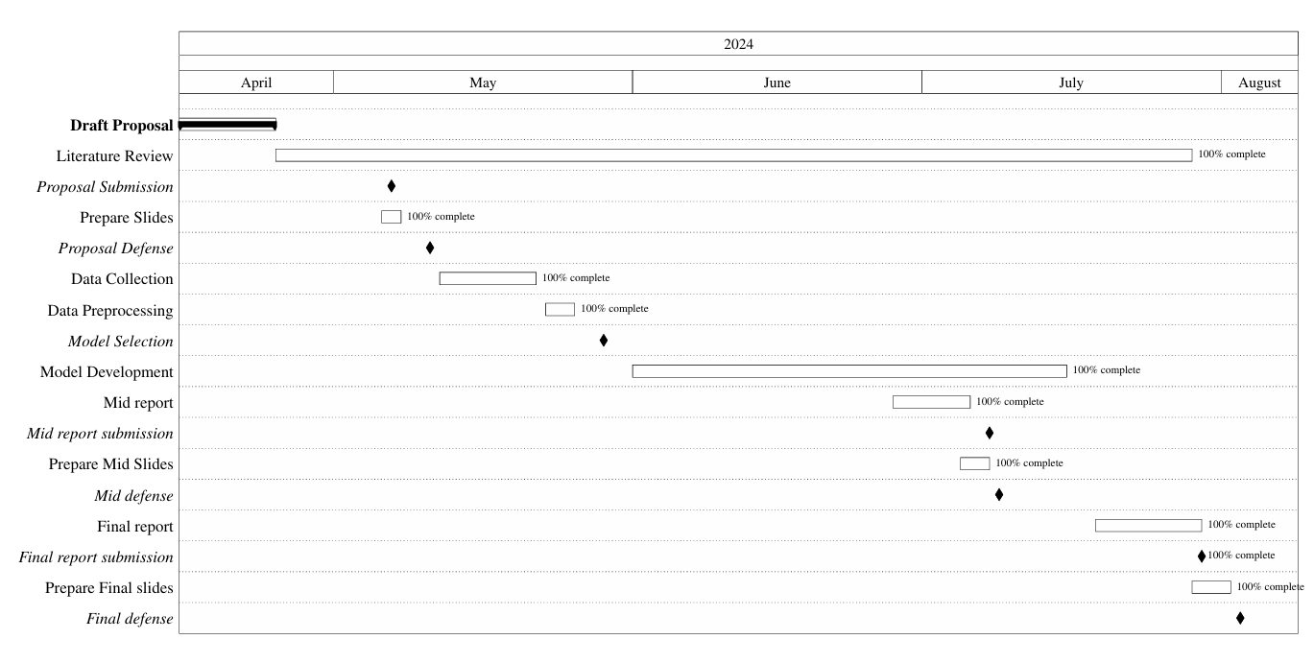
PROJECT SCHEDULE
Fig: Gantt Chart

Slide 49
REFERENCES
1] Han Lock Siew and Md Jan Nordin. Regression techniques for the prediction of stock price trend. In 2012 International Conference on Statistics in Science, Business and Engineering (ICSSBE), pages 1–5, 2012.
[2] Kaustubh Khare, Omkar Darekar, Prafull Gupta, and V. Z. Attar. Short term stock price prediction using deep learning. In 2017 2nd IEEE International Conference on Recent Trends in Electronics, Information Communication Technology (RTEICT), pages 482–486, 2017.

Slide 50
[3] Sreelekshmy Selvin, R Vinayakumar, EA Gopalakrishnan, Vijay Krishna Menon, and KP Soman. Stock price prediction using lstm, rnn and cnn-sliding window model. In 2017 international conference on advances in computing, communications and informatics (icacci), pages 1643–1647. IEEE, 2017.
[4] Adil Moghar and Mhamed Hamiche. Stock market prediction using lstm recurrent neural network. Procedia Computer Science, 170:1168–1173, 2020. The 11th International Conference on Ambient Systems, Networks and Technologies (ANT) / The 3rd International
Conference on Emerging Data and Industry 4.0 (EDI40) / Affiliated Workshops.
[5] Gourav Bathla. Stock price prediction using lstm and svr. In 2020 Sixth International
Conference on Parallel, Distributed and Grid Computing (PDGC), pages 211–214, 2020

Slide 51
THANK YOU......

